Slide 1

Chapter 26
Standard
Client-Server
Protocols
Copyright © The McGraw-Hill Companies, Inc. Permission required for reproduction or display.
Notes:
1

Slide 2
Chapter 26: Outline
26.1 WORLD-WIDE WEB AND HTTP
26.2 FTP
26.3 ELECTRONIC MAIL
26.4 TELNET
26.5 SECURE SHELL (SSH)
26.6 DOMAIN NAME SYSTEM (DNS)
Notes:
26.#

Slide 3

Chapter 26: Objective
The first section introduces the World Wide Web. It then discusses the HyperText Transfer Protocol, the most common client-server application program used in relation to the World Wide Web.
The second section discusses the File Transfer Protocol, which is the standard protocol provided by TCP/IP for copying a file from one host to another.
The third section discusses electronic mail, which involves two protocols: SMPT and POP. As we will see, the nature of this application is different from the other two previous applications. We need two different protocols to handle electronic mail.
Notes:
26.#

Slide 4
Chapter 26: Objective (continued)
The fourth section discusses TELNET, a general client-server program that allows users to log in to a remote machine and use any application available on the remote host.
The fifth section discusses Secure Shell, which can be used as a secured TELNET, but it can also provide a secure tunnel for other applications.
The sixth section talks about the Domain Name System, which acts as the directory system in the Internet. It maps the name of an entity to its IP address.
Notes:
26.#

Slide 5
26-1 WORLD WIDE WEB AND HTTP
In this section, we first introduce the World Wide Web (abbreviated WWW or Web). We then discuss the Hyper-Text Transfer Protocol (HTTP), the most common client-server application program used in relation to the Web.
26.5
Notes:
26.#

Slide 6
26.26.1 World Wide Web
The idea of the Web was first proposed by Tim Berners-Lee in 1989 at CERN, the European Organization for Nuclear Research, to allow several researchers at different locations throughout Europe to access each others’ researches. The commercial Web started in the early 1990s.
26.6
Notes:
26.#

Slide 7
Example 26.1
Assume we need to retrieve a scientific document that contains one reference to another text file and one reference to a large image. Figure 26.1 shows the situation.
The main document and the image are stored in two separate files in the same site (file A and file B); the referenced text file is stored in another site (file C). Since we are dealing with three different files, we need three transactions if we want to see the whole document.
26.7
Notes:
7

Slide 8






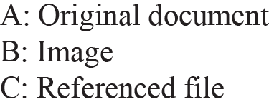





Figure 26.1: Example 26.1
26.8
Notes:
26.#

Slide 9
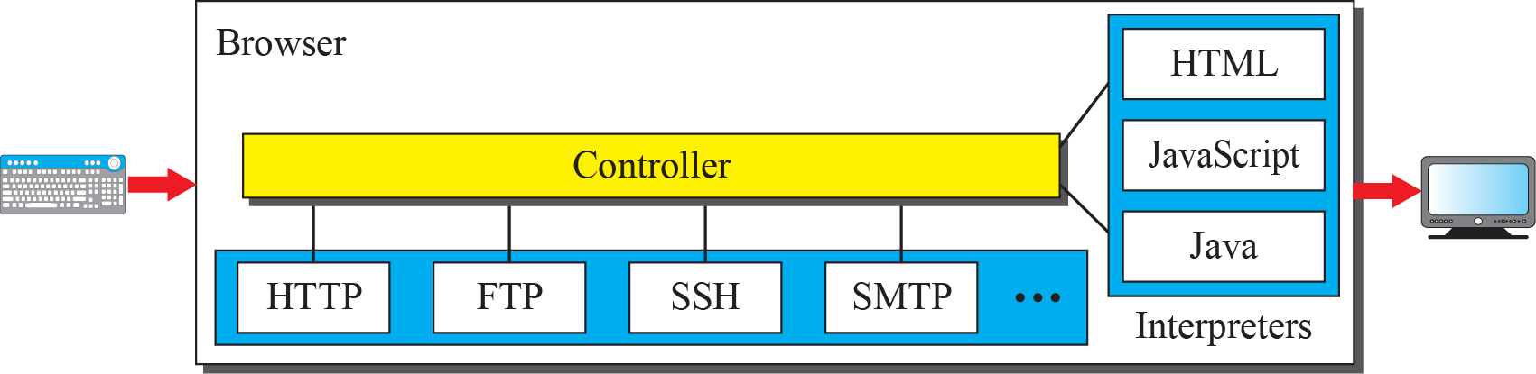
Figure 26.2: Browser
26.9
Notes:
26.#

Slide 10
Example 26.2
The URL http://www.mhhe.com/compsci/forouzan/ defines the web page related to one of the of the computer in the McGraw-Hill company (the three letters www are part of the host name and are added to the commercial host). The path is compsci/forouzan/, which defines Forouzan’s web page under the directory compsci (computer science).
26.10
Notes:
10

Slide 11
26.26.2 HyperText Transfer Protocol
The HyperText Transfer Protocol (HTTP) is used to define how the client-server programs can be written to retrieve web pages from the Web. An HTTP client sends a request; an HTTP server returns a response. The server uses the port number 80; the client uses a temporary port number. HTTP uses the services of TCP, which, as discussed before, is a connection-oriented and reliable protocol.
26.11
Notes:
26.#

Slide 12
Example 26.3
Figure 26.3 shows an example of a nonpersistent connection. The client needs to access a file that contains one link to an image. The text file and image are located on the same server. Here we need two connections. For each connection, TCP requires at least three handshake messages to establish the connection, but the request can be sent with the third one. After the connection is established, the object can be transferred. After receiving an object, another three handshake messages are needed to terminate the connection, as we will see in Chapter 23.
26.12
Notes:
12

Slide 13
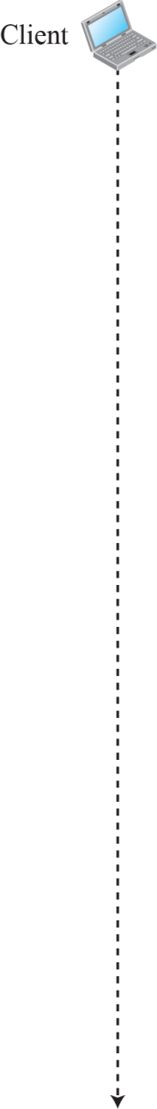
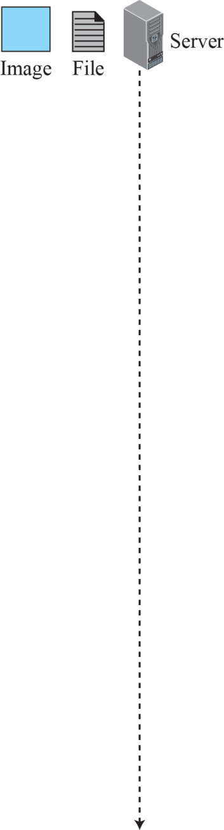
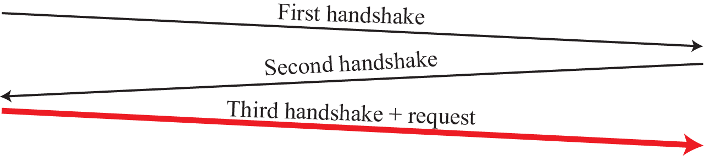

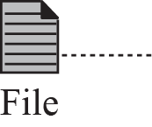
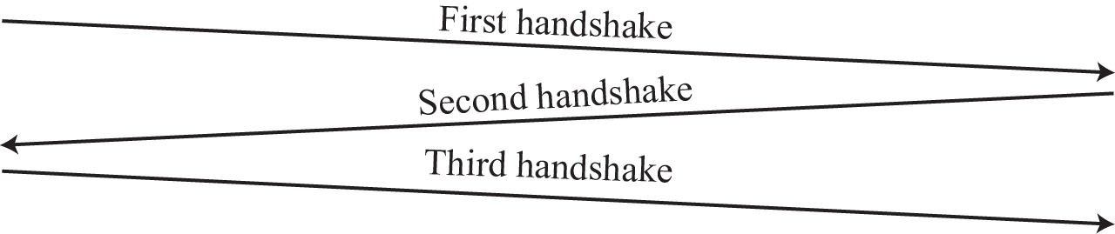

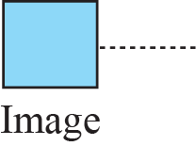
Figure 26.3: Example 26.3
26.13
Notes:
26.#

Slide 14
Example 26.4
Figure 26.4 shows the same scenario as in Example 26.3, but using a persistent connection. Only one connection establishment and connection termination is used, but the request for the image is sent separately.
26.14
Notes:
14

Slide 15
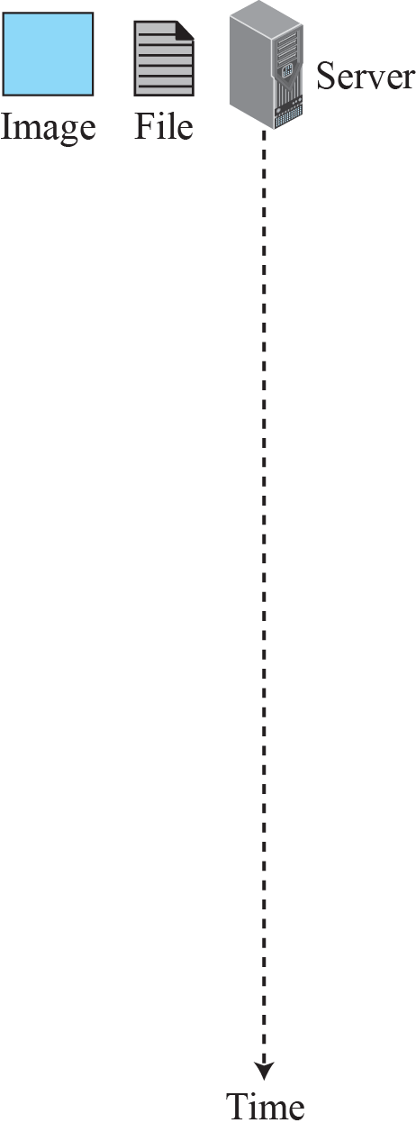

Figure 26.4: Example 26.4
26.15
Notes:
26.#

Slide 16
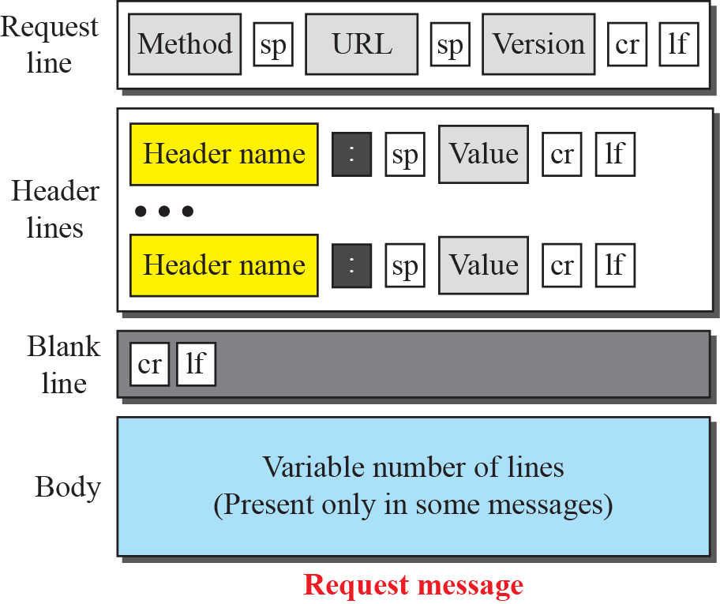
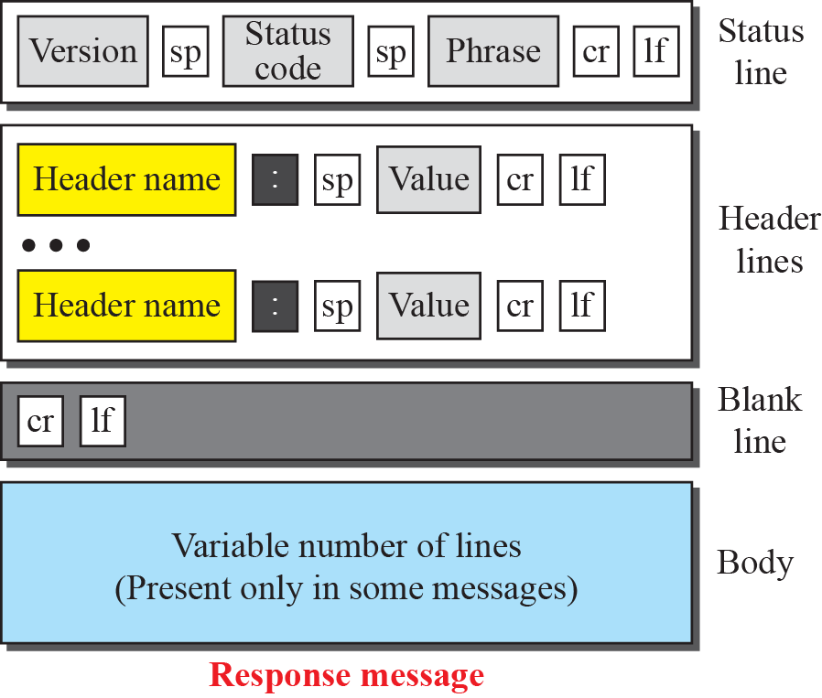
Figure 26.5: Formats of the request and response messages
status
26.16
Notes:
26.#

Slide 17
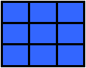
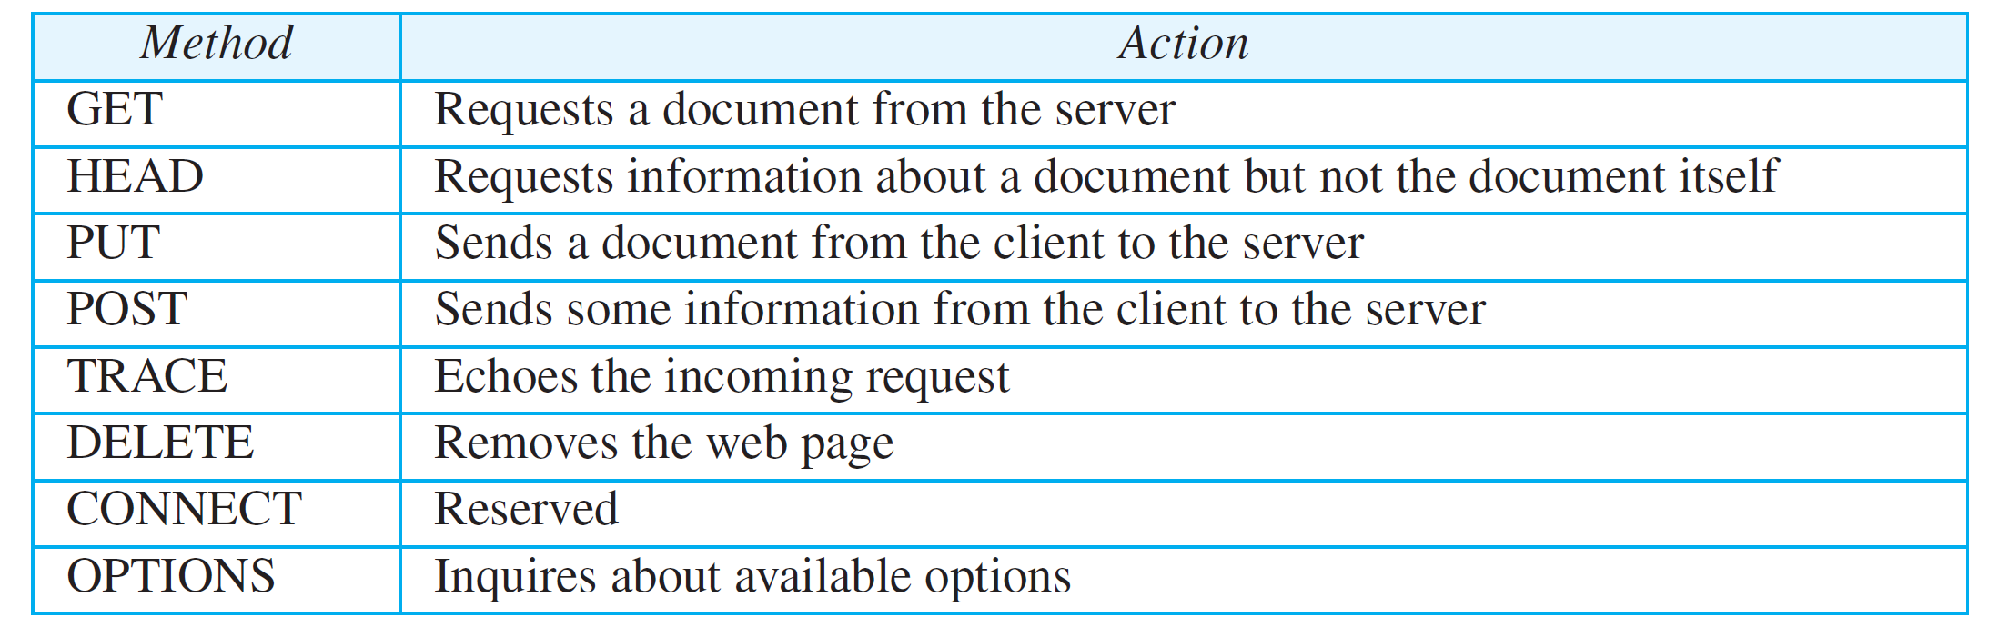
Table 26.1: Methods
26.17
Notes:
17

Slide 18
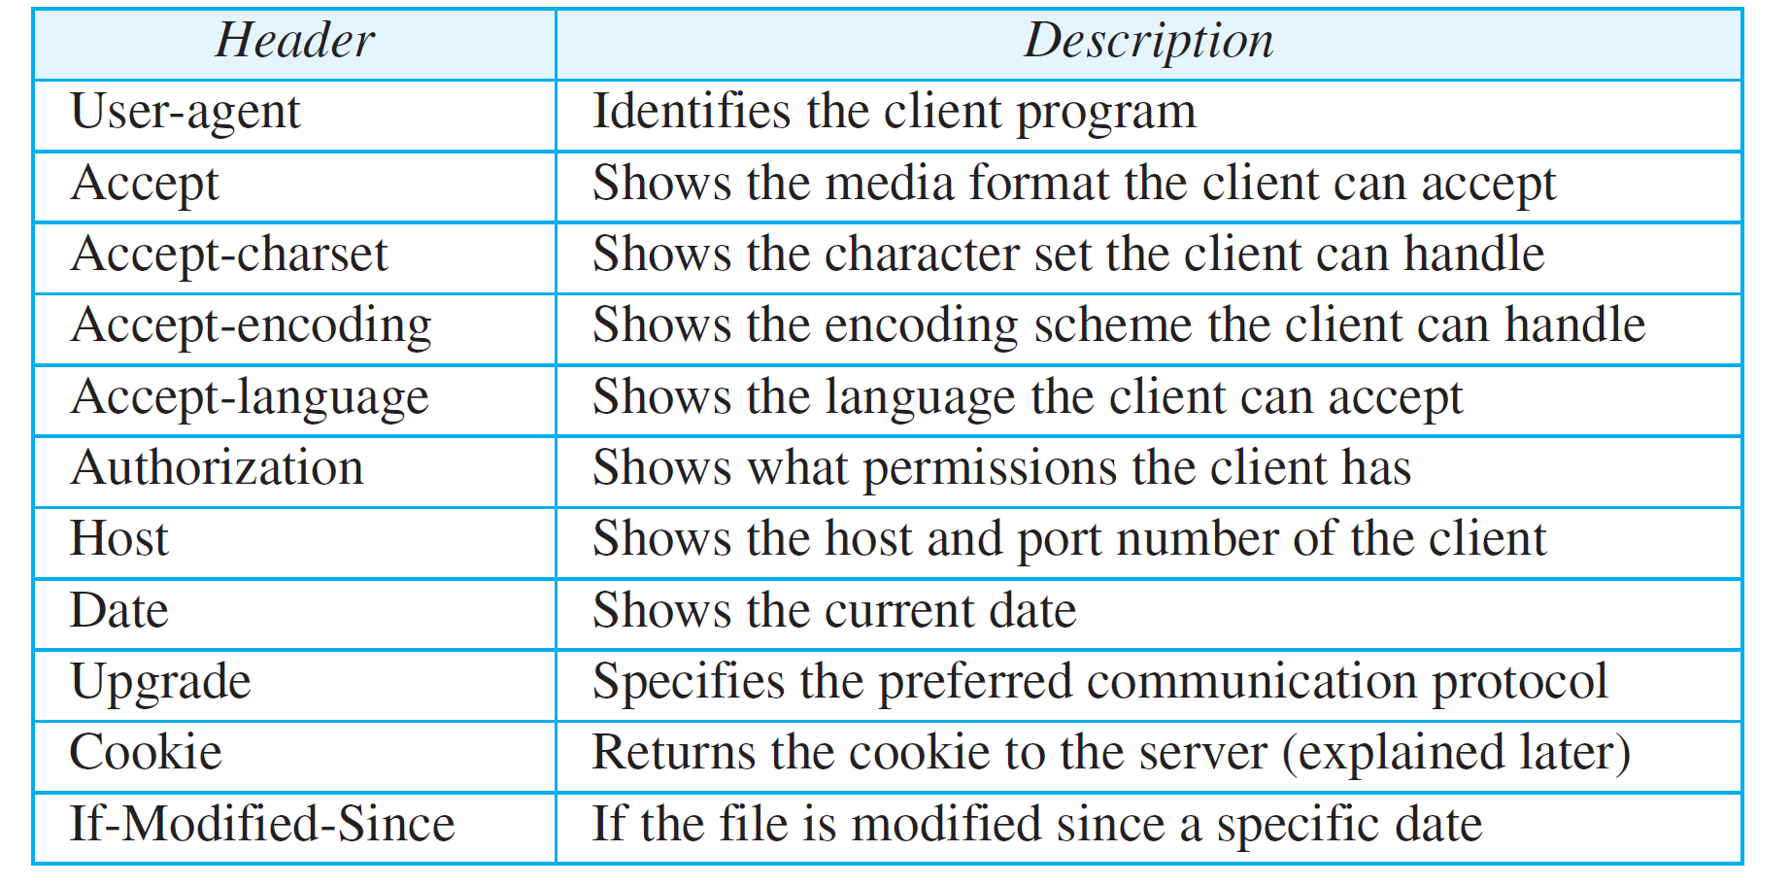
Table 26.2: Request Header Names
26.18
Notes:
18

Slide 19
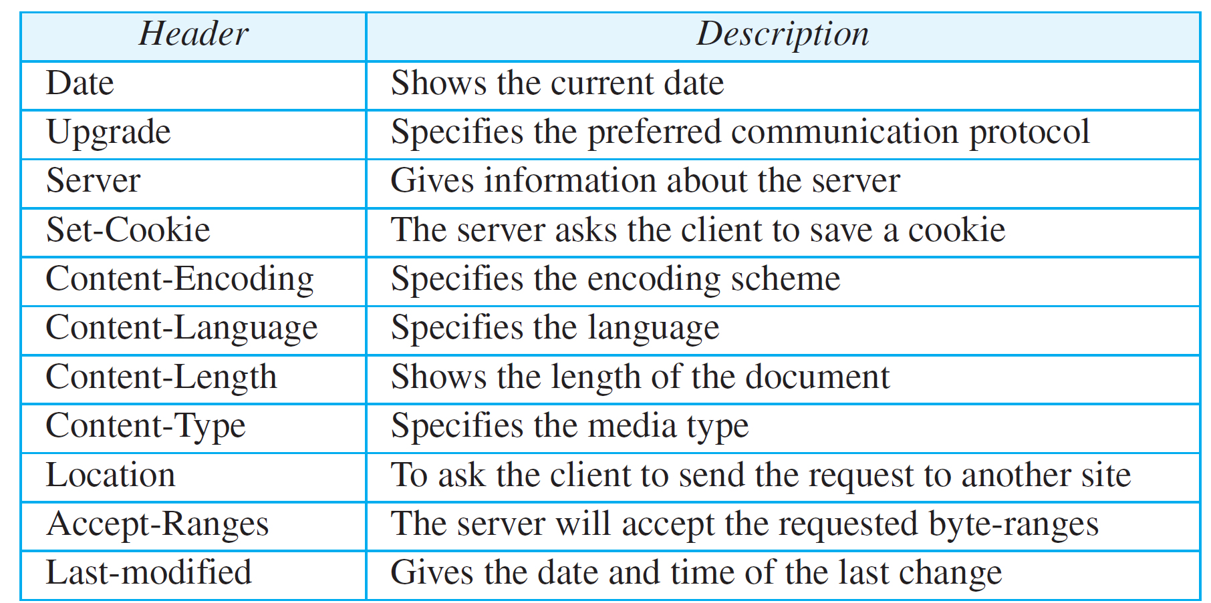
Table 26.3: Response Header Names
26.19
Notes:
19

Slide 20
Example 2656
This example retrieves a document (see Figure 26.6). We use the GET method to retrieve an image with the path /usr/bin/image26. The request line shows the method (GET), the URL, and the HTTP version (26.1). The header has two lines that show that the client can accept images in the GIF or JPEG format. The request does not have a body. The response message contains the status line and four lines of header. The header lines define the date, server, content encoding (MIME version, which will be described in electronic mail), and length of the document. The body of the document follows the header..
26.20
Notes:
20

Slide 21
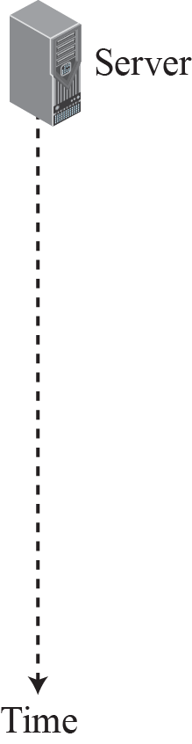
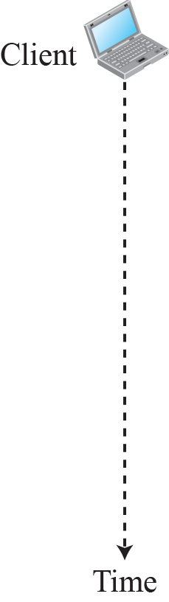
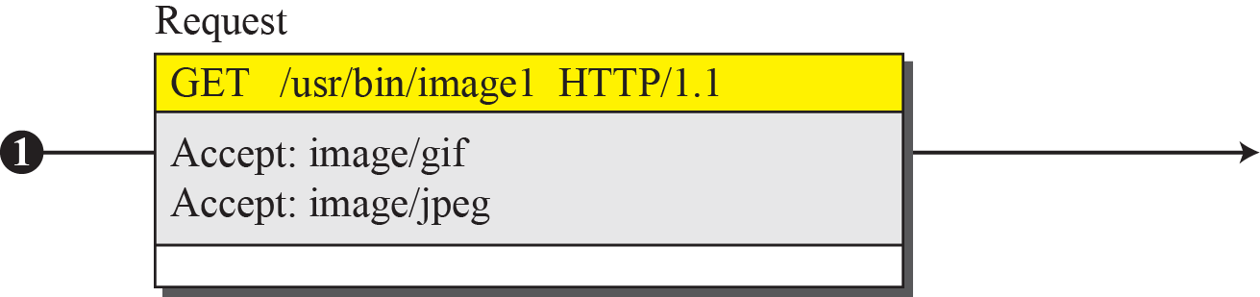
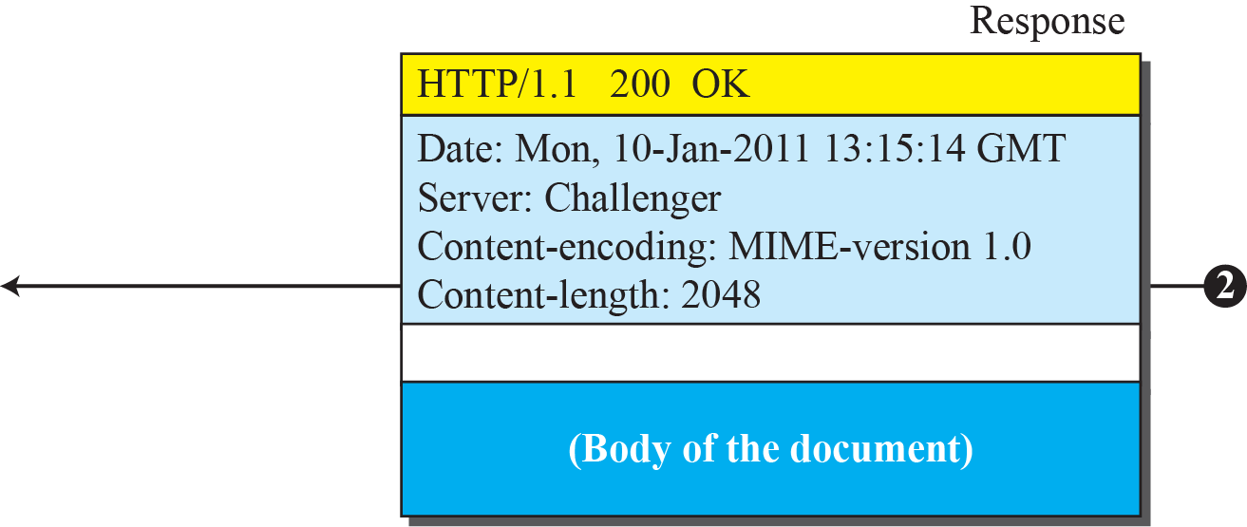
Figure 26.6: Example 26.5
26.21
Notes:
26.#

Slide 22
Example 26.6
In this example, the client wants to send a web page to be posted on the server. We use the PUT method. The request line shows the method (PUT), URL, and HTTP version (26.1). There are four lines of headers. The request body contains the web page to be posted. The response message contains the status line and four lines of headers. The created document, which is a CGI document, is included as the body (see Figure 26.7).
26.22
Notes:
22

Slide 23
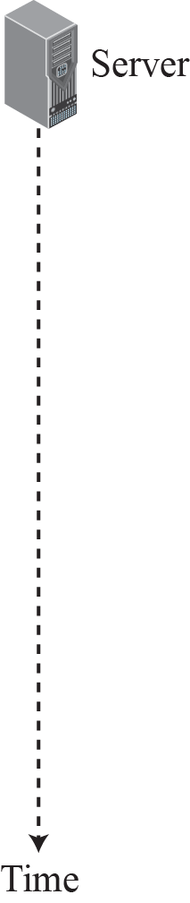
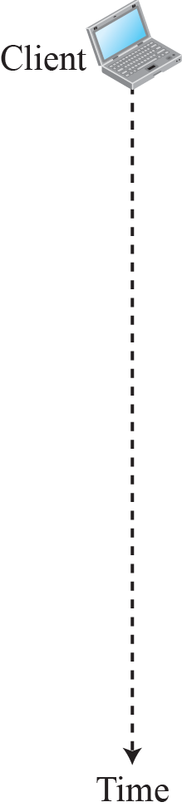
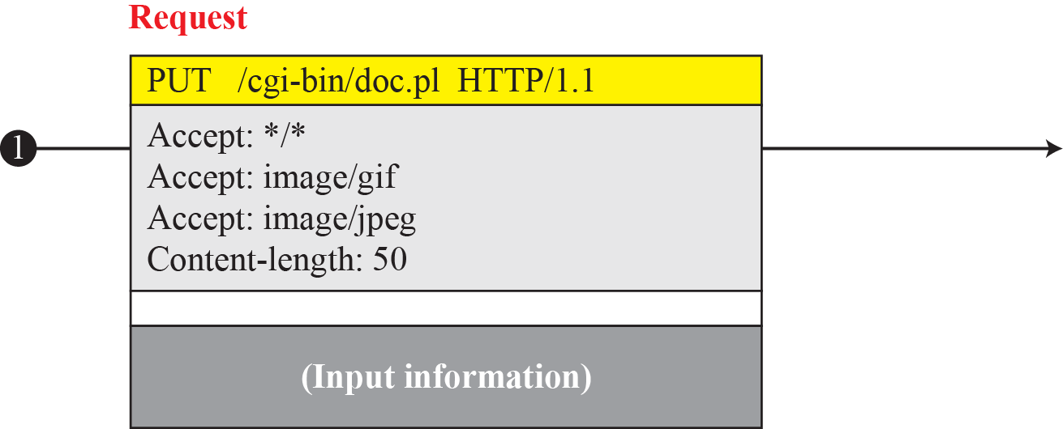
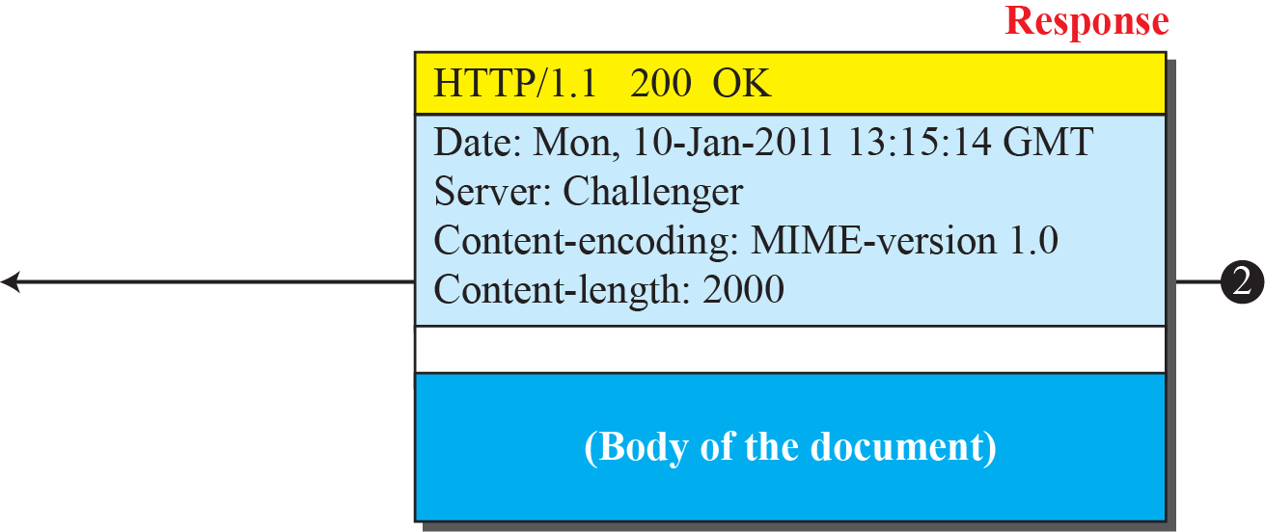
Figure 26.7: Example 26.6
26.23
Notes:
26.#

Slide 24
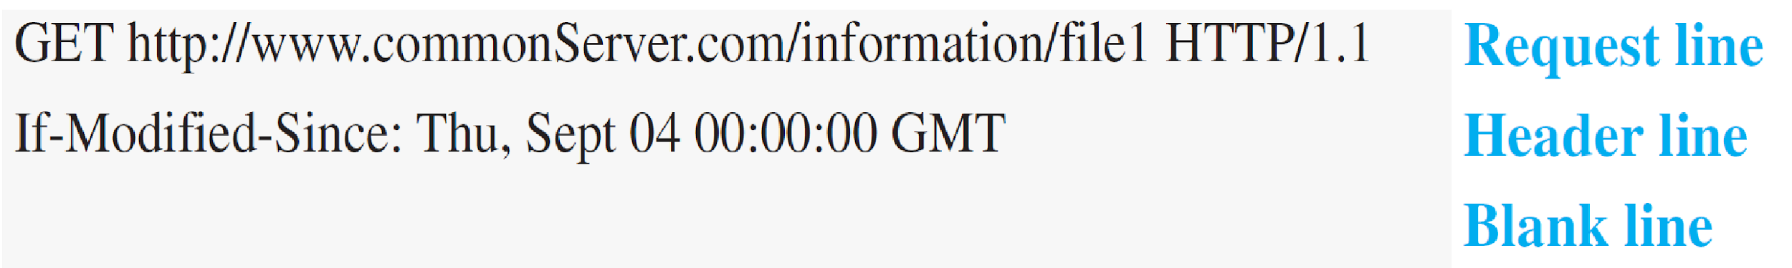
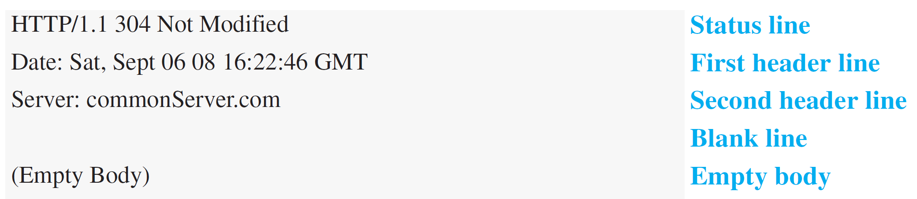
Example 26.7
The following shows how a client imposes the modification data and time condition on a request.
The status line in the response shows the file was not modified after the defined point in time. The body of the response message is also empty.
26.24
Notes:
24

Slide 25
Example 26.8
Figure 26.8 shows a scenario in which an electronic store can benefit from the use of cookies. Assume a shopper wants to buy a toy from an electronic store named BestToys. The shopper browser (client) sends a request to the BestToys server. The server creates an empty shopping cart (a list) for the client and assigns an ID to the cart (for example, 12343). The server then sends a response message, which contains the images of all toys available, with a link under each toy that selects the toy if it is being clicked. This response message also includes the Set-Cookie header line whose value is 12343. The client displays the images and stores the cookie value in a file named BestToys.
26.25
Notes:
25

Slide 26
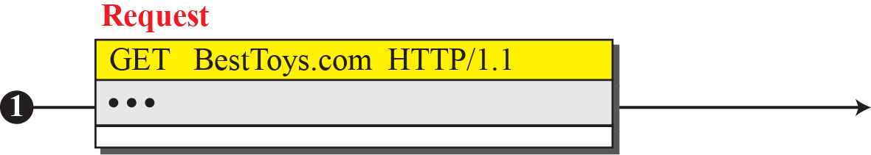
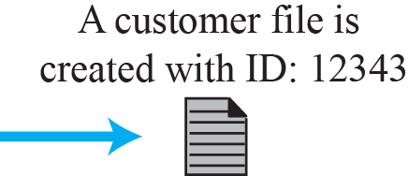
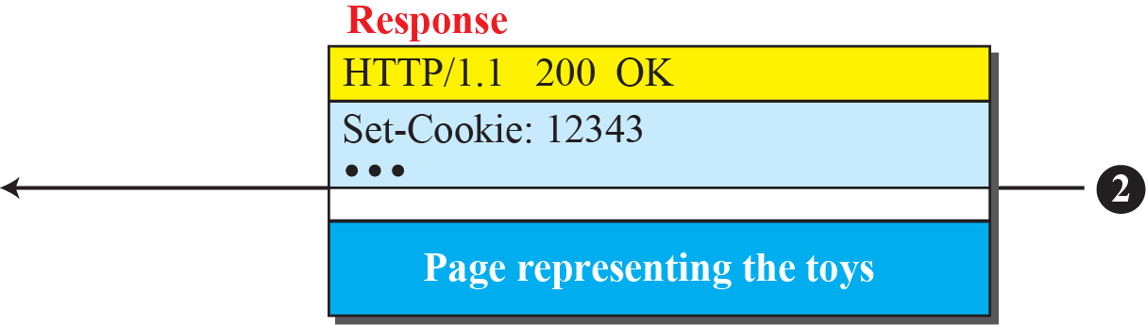

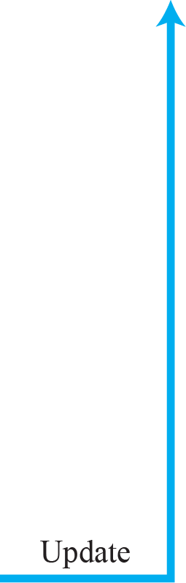

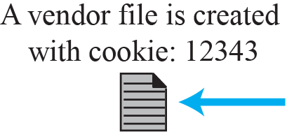


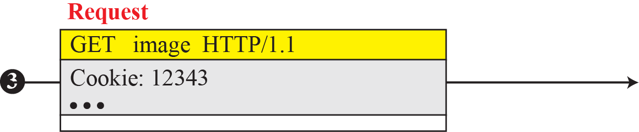
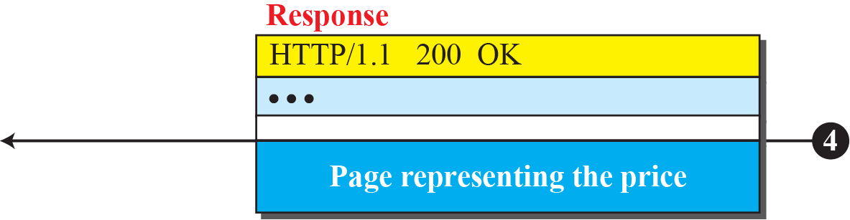
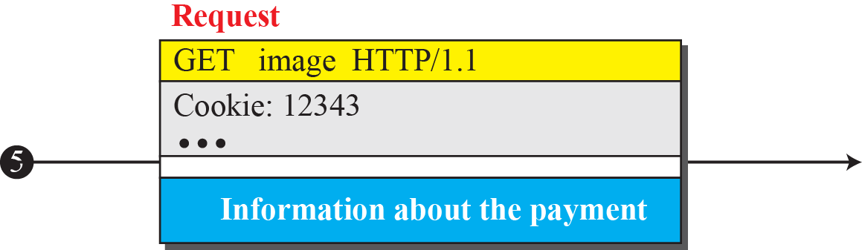
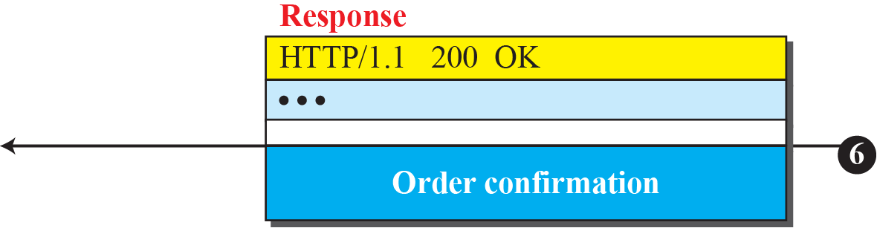
Figure 26.8: Example 26.8
26.26
Notes:
26.#

Slide 27
Example 26.9
Figure 26.9 shows an example of a use of a proxy server in a local network, such as the network on a campus or in a company. The proxy server is installed in the local network. When an HTTP request is created by any of the clients (browsers), the request is first directed to the proxy server If the proxy server already has the corresponding web page, it sends the response to the client. Otherwise, the proxy server acts as a client and sends the request to the web server in the Internet. When the response is returned, the proxy server makes a copy and stores it in its cache before sending it to the requesting client.
26.27
Notes:
27

Slide 28
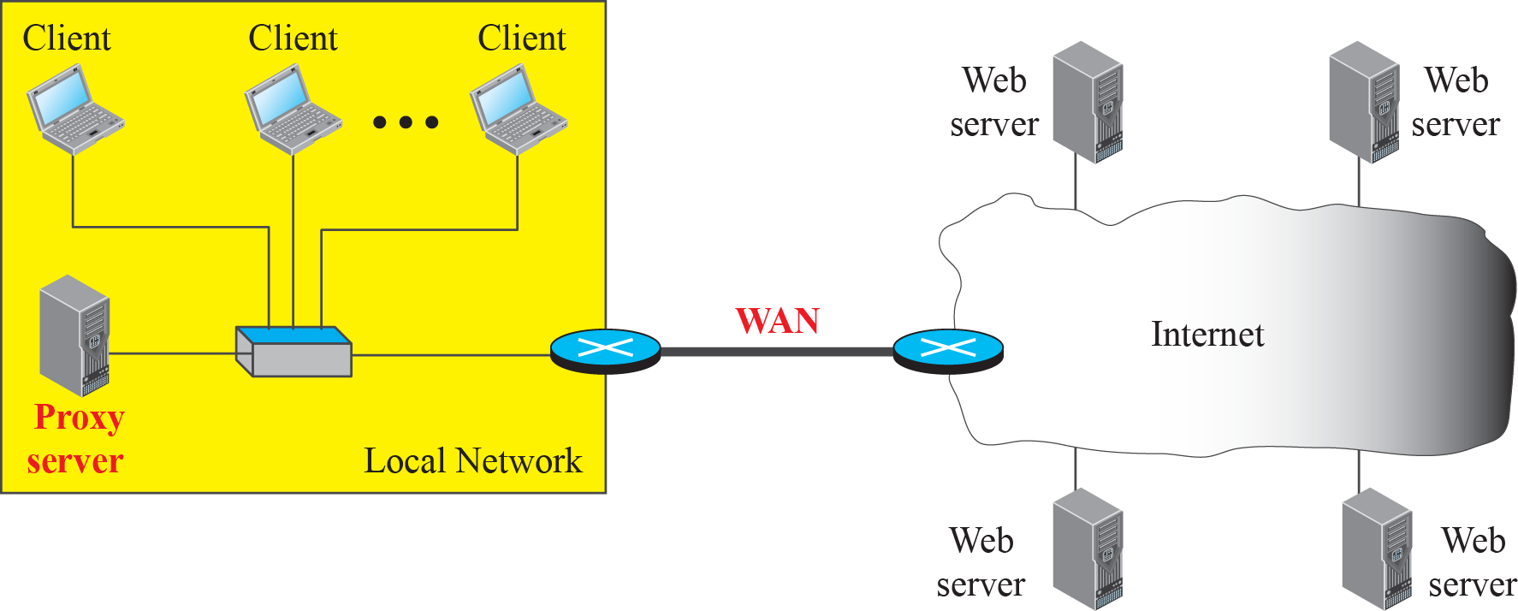
Figure 26.9: Example of a proxy server
26.28
Notes:
26.#

Slide 29
26-2 FTP
File Transfer Protocol (FTP) is the standard protocol provided by TCP/IP for copying a file from one host to another. Although transferring files from one system to another seems simple and straightforward, some problems must be dealt with first.
26.29
Notes:
26.#

Slide 30
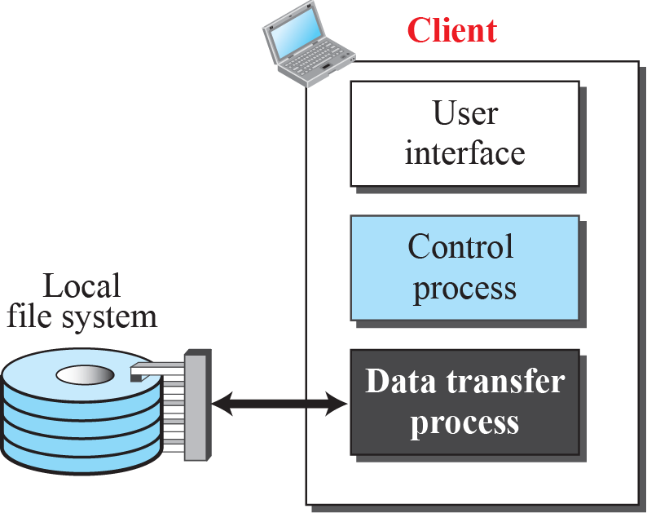
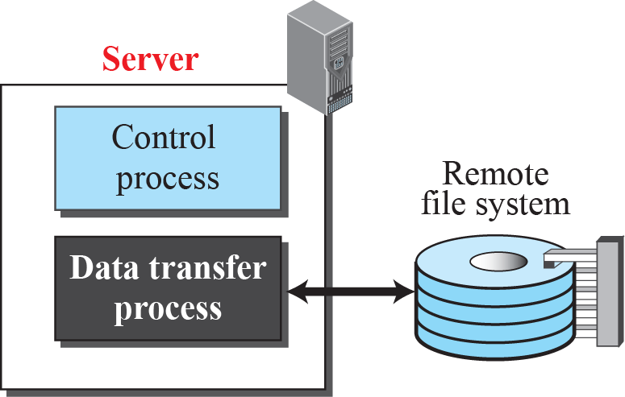
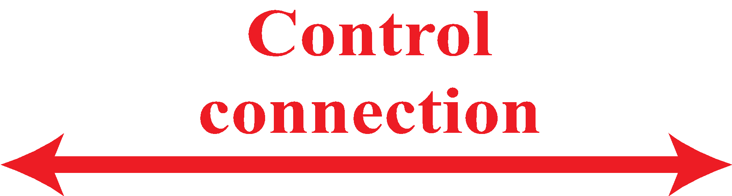
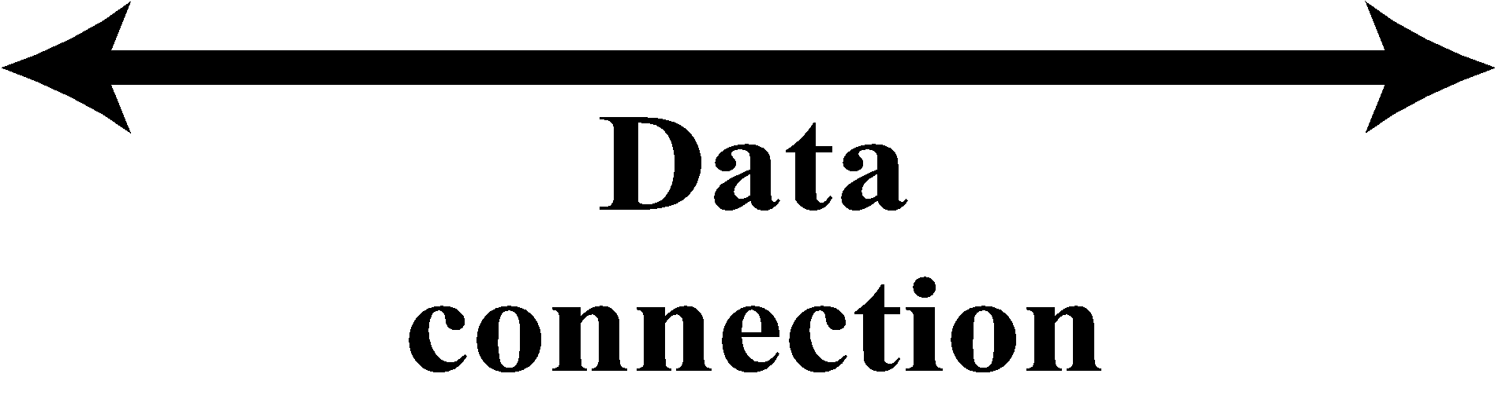
Figure 26.10: FTP
26.30
Notes:
26.#

Slide 31
26.2.1 Two Connections
The two connections in FTP have different lifetimes. The control connection remains connected during the entire interactive FTP session. The data connection is opened and then closed for each file transfer activity. It opens each time commands that involve transferring files are used, and it closes when the file is transferred.
26.31
Notes:
26.#

Slide 32
26.2.2 Control Connection
For control communication, FTP uses the same approach as TELNET (discussed later). It uses the NVT ASCII character set as used by TELNET. Communication is achieved through commands and responses. This simple method is adequate for the control connection because we send one command (or response) at a time. Each line is terminated with a two-character (carriage return and line feed) end-of-line token.
26.32
Notes:
26.#

Slide 33
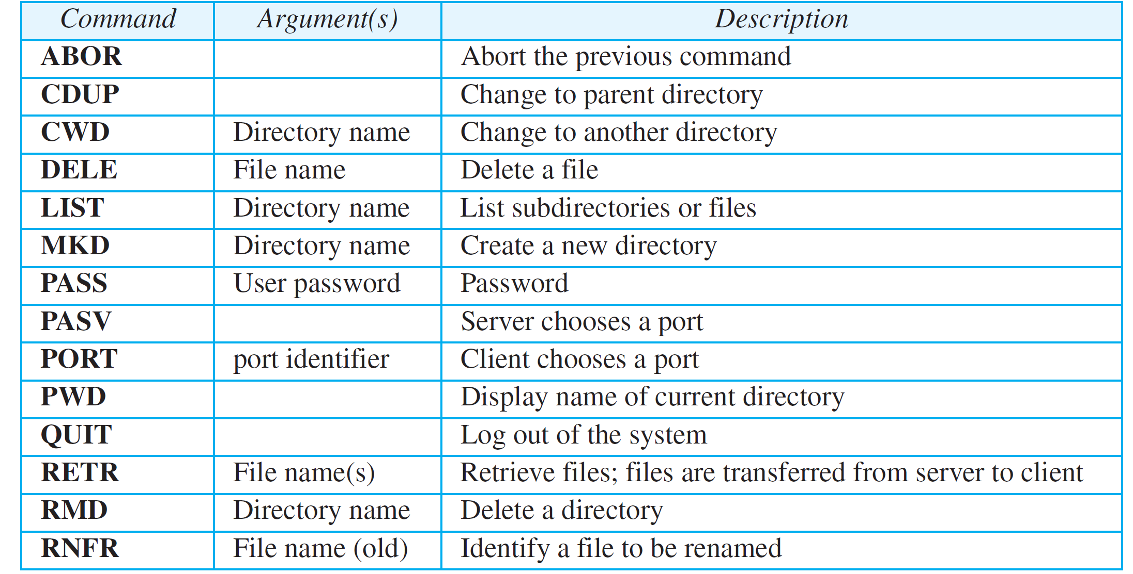
Table 26.4: Some FTP commands
26.33
Notes:
33

Slide 34
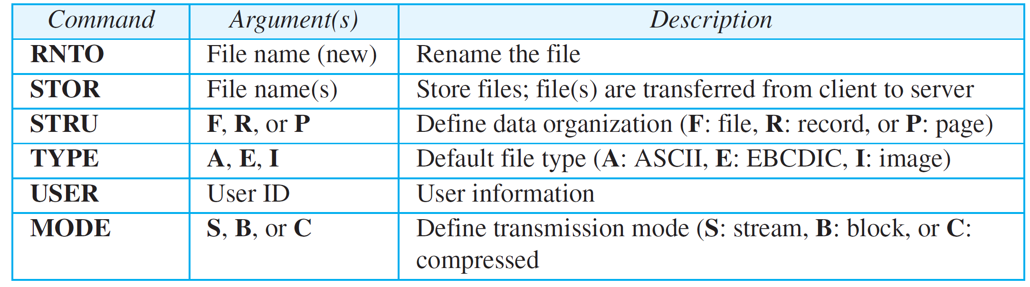
Table 26.4 : Some FTP commands (continued)
26.34
Notes:
34

Slide 35
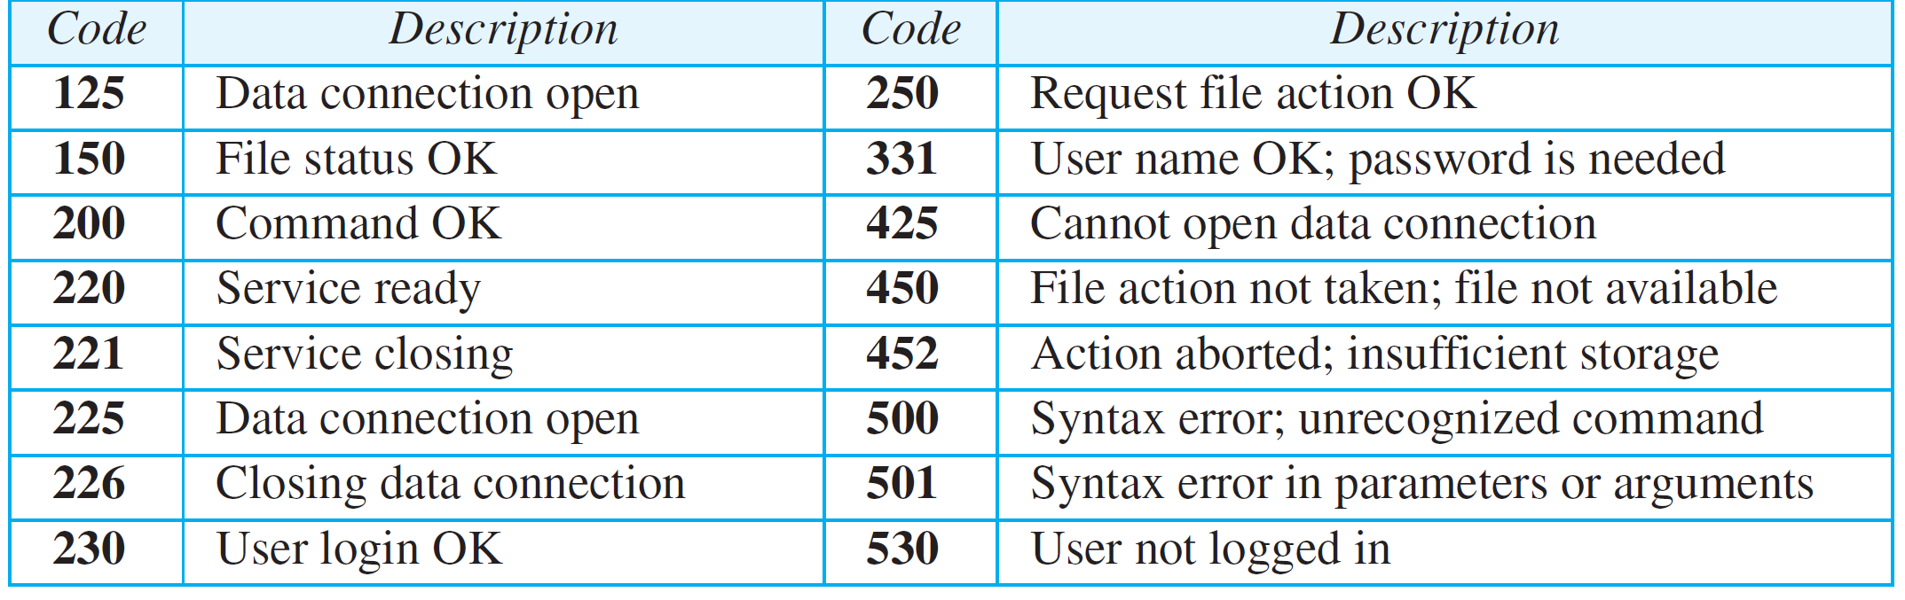
Table 26.5: Some responses in FTP
26.35
Notes:
35

Slide 36
26.2.3 Data Connection
The data connection uses the well-known port 20 at the server site. However, the creation of a data connection is different from the control connection. The following shows the steps:
The client, not the server, issues a passive open using an ephemeral port.
Using the PORT command the client sends this port number to the server.
3. The server receives the port number and issues an active open using the well-known port 20 and the received ephemeral port number.
26.36
Notes:
26.#

Slide 37
Example 26.10
Figure 26.11 shows an example of using FTP for retrieving a file. The figure shows only one file to be transferred. The control connection remains open all the time, but the data connection is opened and closed repeatedly. We assume the file is transferred in six sections. After all records have been transferred, the server control process announces that the file transfer is done. Since the client control process has no file to retrieve, it issues the QUIT command, which causes the service connection to be closed.
26.37
Notes:
37

Slide 38
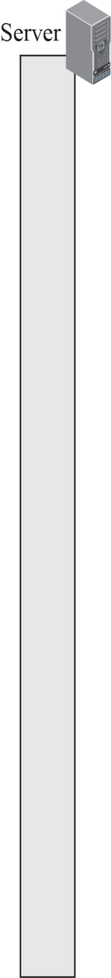

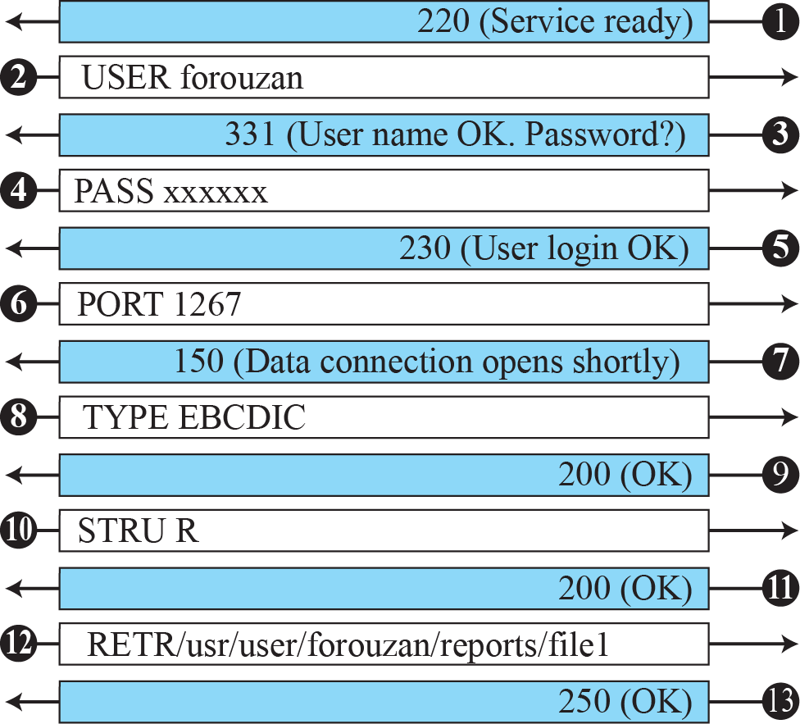
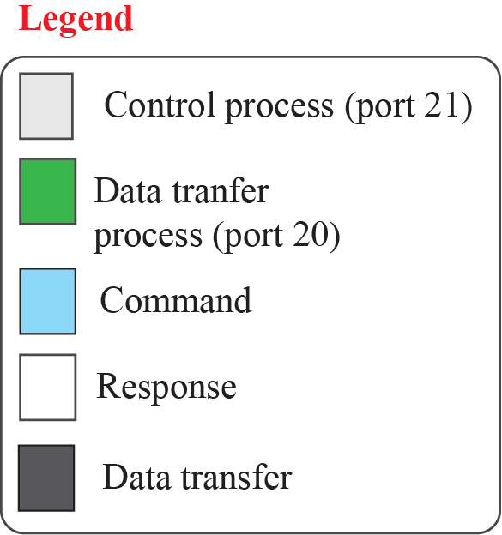

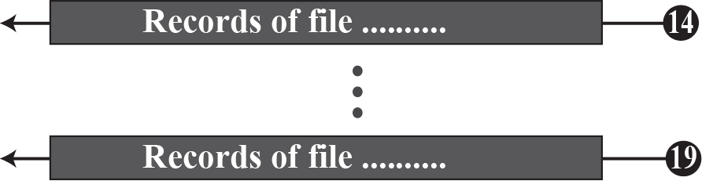
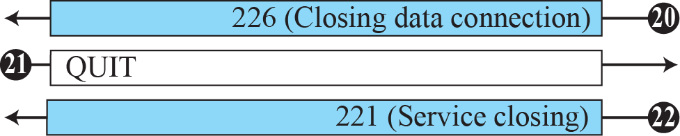
Figure 26.11: Example 26.12
26.38
Notes:
26.#

Slide 39
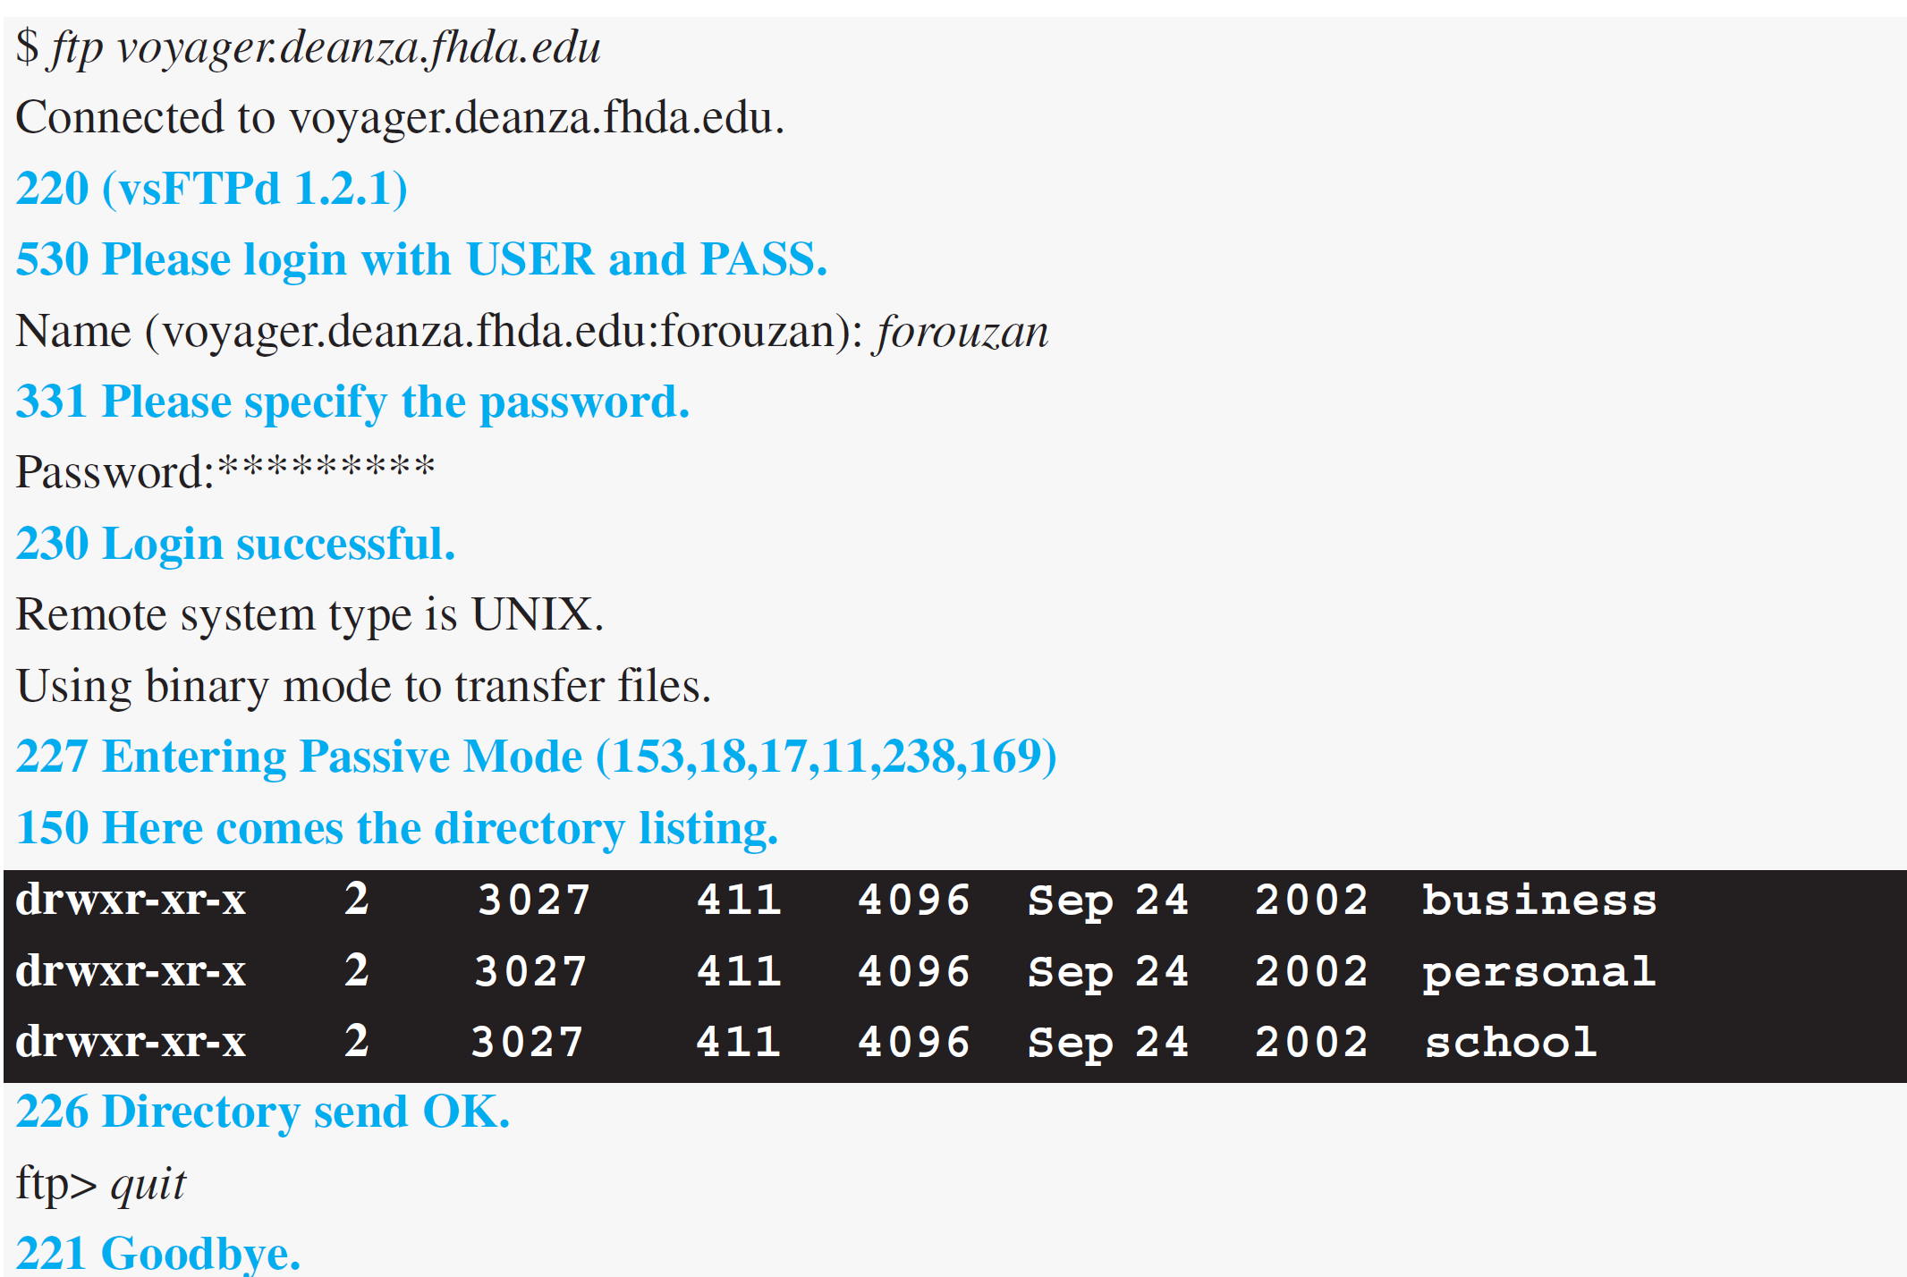
Example 26.11
The following shows an actual FTP session that lists the directories.
26.39
Notes:
39

Slide 40
26.2.4 Security for FTP
The FTP protocol was designed when security was not a big issue. Although FTP requires a password, the password is sent in plaintext (unencrypted), which means it can be intercepted and used by an attacker. The data transfer connection also transfers data in plaintext, which is insecure. To be secure, one can add a Secure Socket Layer between the FTP
application layer and the TCP layer. In this case FTP is called SSL-FTP. We also explore some secure file transfer applications when we discuss SSH later in the chapter.
26.40
Notes:
26.#

Slide 41
26-3 ELECTRONIC MAIL
Electronic mail (or e-mail) allows users to exchange messages. The nature of this application is different from other applications discussed so far. This means that the idea of client/server programming should be implemented in another way: using some intermediate computers (servers).
26.41
Notes:
26.#

Slide 42
26.3.1 Architecture
To explain the architecture of e-mail, we give a common scenario, as shown in Figure 26.12. Another possibility is the case in which Alice or Bob is directly connected to the corresponding mail server, in which LAN or WAN connection is not required, but this variation in the scenario does not affect our discussion.
26.42
Notes:
26.#

Slide 43
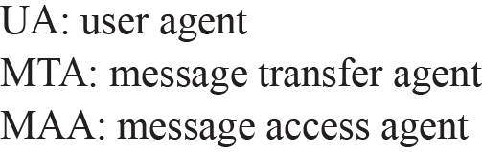
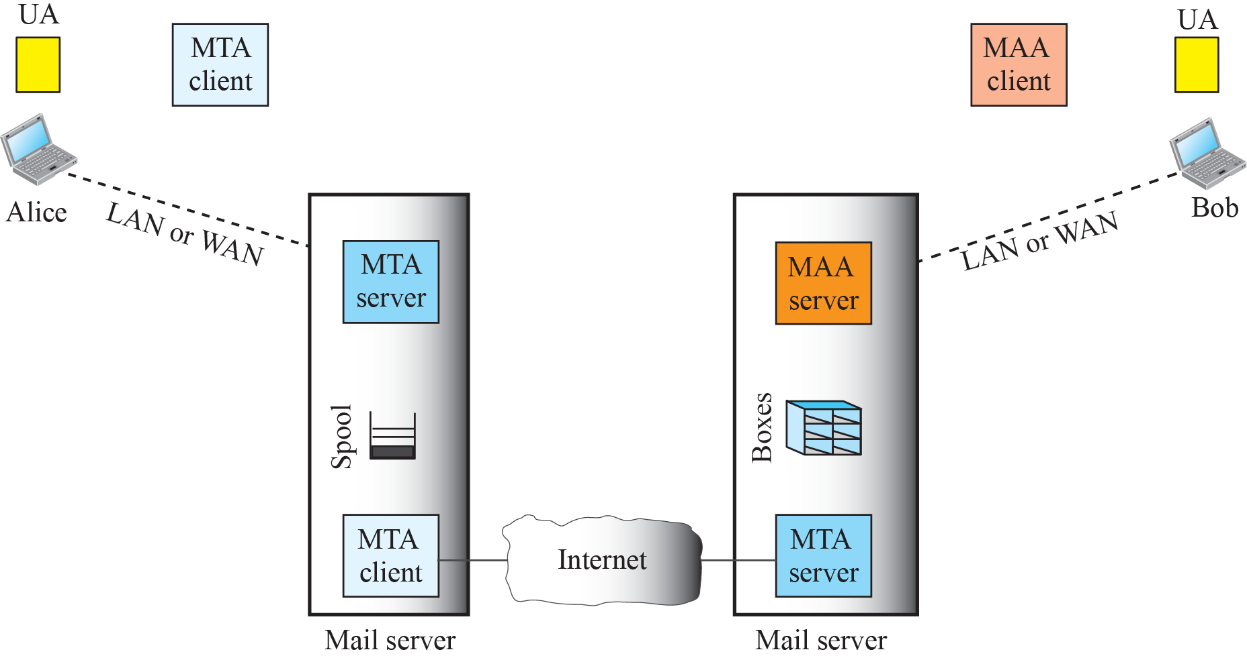









Figure 26.12: Common scenario
26.43
Notes:
26.#

Slide 44




Figure 26.13: Format of an e-mail
26.44
Notes:
26.#

Slide 45



Figure 26.14: E-mail address
26.45
Notes:
26.#

Slide 46




Figure 26.15: Protocols used in electronic mail
26.46
Notes:
26.#

Slide 47


Table 26.6: SMTP Commands
26.47
Notes:
47

Slide 48

Table 26.7: SMTP responses (Continued)
26.48
Notes:
48

Slide 49

Table 26.7: SMTP responses (continued)
26.49
Notes:
49

Slide 50
Example 26.12
To show the three mail transfer phases, we show all of the steps described above using the information depicted in Figure 26.16. In the figure, we have separated the messages related to the envelope, header, and body in the data transfer section. Note that the steps in this figure are repeated two times in each e-mail transfer: once from the e-mail sender to the local mail server and once from the local mail server to the remote mail server. The local mail server, after receiving the whole e-mail message, may spool it and send it to the remote mail server at another time.
26.50
Notes:
50

Slide 51










Figure 26.16: Example 26.12
26.51
Notes:
26.#

Slide 52



Figure 26.17: POP3
26.52
Notes:
26.#

Slide 53




Figure 26.18: MIME
26.53
Notes:
26.#

Slide 54

Figure 26.19: MIME header
26.54
Notes:
26.#

Slide 55

Table 26.8: Data Types and Subtypes in MIME
26.55
Notes:
55

Slide 56

Table 2.9: Methods for Content-Transfer-Encoding
26.56
Notes:
56

Slide 57




Figure 26.20: Base64 conversion
26.57
Notes:
26.#

Slide 58

Table 26.10: Base64 Converting Table
26.58
Notes:
58

Slide 59


Figure 26.21: Quoted-printable
26.59
Notes:
26.#

Slide 60
26.3.2 E-Mail Security
The protocol discussed in this chapter does not provide any security provisions per se. However, e-mail exchanges can be secured using two application-layer securities designed in particular for e-mail systems. Two of these protocols, Pretty Good Privacy (PGP) and Secure/Multipurpose Internet Mail Extensions (S/MIME), are discussed in Chapter 32 after we have discussed basic network security.
26.60
Notes:
26.#

Slide 61


Figure 26.22: Web-based e-mail, cases I and II
26.61
Notes:
26.#

Slide 62
26.3.3 Iter. Programming Using TCP
We are now ready to discuss network programming using the service of TCP, a connection-oriented service.
26.62
Notes:
26.#

Slide 63
26-4 TELNET
It is impossible to have a client/server pair for each type of service we need; the number of servers soon becomes intractable. The idea is not scalable. The solution is to have a specific client/server program for a set of common scenarios, but to have some generic client/server programs for the rest.
26.63
Notes:
26.#

Slide 64
26.4.1 Local versus Remote Logging
We first discuss the concept of local and remote logging as shown in Figure 26.23.
26.64
Notes:
26.#

Slide 65


Figure 2.23: Local versus remote logging
26.65
Notes:
26.#

Slide 66


Figure 26.24: Concept of NVT
While connecting response is coming for connection
26.66
Notes:
26.#

Slide 67

Table 26.11: Examples of interface commands
26.67
Notes:
67

Slide 68
26-5 SECURE SHELL (SSH)
Although Secure Shell (SSH) is a secure application program that can be used today for several purposes such as remote logging and file transfer, it was originally designed to replace TELNET. There are two versions of SSH. The first version, SSH-1, is now deprecated because of security flaws in it. In this section, we discuss only SSH-2.
26.68
Notes:
26.#

Slide 69
26.5.1 Components
SSH is an application-layer protocol with three components, as shown in Figure 26.25.
26.69
Notes:
26.#

Slide 70

Figure 26.25: Components of SSH
26.70
Notes:
26.#

Slide 71
26.5.2 Applications
Although SSH is often thought of as a replacement for TELNET, SSH is, in fact, a general-purpose protocol that provides a secure connection between a client and server.
26.71
Notes:
26.#

Slide 72



Figure 26.26: Port Forwarding
26.72
Notes:
26.#

Slide 73

Figure 26.27: SSH Packet Format
26.73
Notes:
26.#

Slide 74
26-6 DOMAIN NAME SYSTEM (DNS)
The last client-server application program we discuss has been designed to help other application programs. The Internet needs to have a directory system that can map a name to an address. This is analogous to the telephone network. Figure 26.28 shows how TCP/IP uses a DNS client and a DNS server to map a name to an address.
26.74
Notes:
26.#

Slide 75










Figure 26.28: Purpose of DNS
26.75
Notes:
26.#

Slide 76
26.6.1 Name Space
To be unambiguous, the names assigned to machines must be carefully selected from a name space with complete control over the binding between the names and IP addresses. In other words, the names must be unique because the addresses are unique. A name space that maps each address to a unique name can be organized in two ways: flat or hierarchical.
26.76
Notes:
26.#

Slide 77

Figure 26.29: Domain name space
26.77
Notes:
26.#

Slide 78









Figure 26.30: Domain names and labels
26.78
Notes:
26.#

Slide 79




Figure 26.31: Domains
26.79
Notes:
26.#

Slide 80

Figure 26.32: Hierarchy of name servers
26.80
Notes:
26.#

Slide 81

Figure 26.33: Zone
26.81
Notes:
26.#

Slide 82
26.6.2 DNS in the Internet
DNS is a protocol that can be used in different platforms. In the Internet, the domain name space (tree) was originally divided into three different sections: generic domains, country domains, and the inverse domains. However, due to the rapid growth of the Internet, it became extremely difficult to keep track of the inverse domains, which could be used to find the name of a host when given the IP address. The inverse domains are now deprecated (see RFC 3425). We, therefore, concentrate on the first two.
26.82
Notes:
26.#

Slide 83

Figure 26.34: Generic domains
26.83
Notes:
26.#

Slide 84


Table 26.12: Generic domain labels
26.84
Notes:
84

Slide 85

Figure 26.35: Country domains
26.85
Notes:
26.#

Slide 86
26.6.3 Resolution
Mapping a name to an address is called name-address resolution. DNS is designed as a client-server application. A host that needs to map an address to a name or a name to an address calls a DNS client called a resolver. The resolver accesses the closest DNS server with a mapping request. If the server has the information, it satisfies the resolver; otherwise, it either refers the resolver to other servers or asks other servers to provide the information.
26.86
Notes:
26.#

Slide 87













Figure 26.36: Recursive resolution
26.87
Notes:
26.#

Slide 88








Figure 26.37: Iterative resolution
26.88
Notes:
26.#

Slide 89
26.6.4 Caching
Each time a server receives a query for a name that is not in its domain, it needs to search its database for a server IP address. Reduction of this search time would increase efficiency. DNS handles this with a mechanism called caching.
26.89
Notes:
26.#

Slide 90
26.6.5 Resource Records
The zone information associated with a server is implemented as a set of resource records. In other words, a name server stores a database of resource records. A resource record is a 5-tuple structure, as shown below:
26.90
Notes:
26.#

Slide 91

Table 26.13: DNS types
26.91
Notes:
91

Slide 92
26.6.6 DNS Messages
To retrieve information about hosts, DNS uses two types of messages: query and response. Both types have the same format as shown in Figure 26.38.
26.92
Notes:
26.#

Slide 93



Figure 26.38: DNS message
26.93
Notes:
26.#

Slide 94

Example 26.13
In UNIX and Windows, the nslookup utility can be used to retrieve address/name mapping. The following shows how we can retrieve an address when the domain name is given.
26.94
Notes:
94

Slide 95
26.6.7 Registrars
How are new domains added to DNS? This is done through a registrar, a commercial entity accredited by ICANN. A registrar first verifies that the requested domain name is unique and then enters it into the DNS database.
26.95
Notes:
26.#

Slide 96
26.6.8 DDNS
When the DNS was designed, no one predicted that there would be so many address changes. In DNS, when there is a change, such as adding a new host, removing a host, or changing an IP address, the change must be made to the DNS master file. These types of changes involve a lot of manual updating. The size of today’s Internet does not allow for this kind of manual operation.
26.96
Notes:
26.#

Slide 97
26.6.9 Security of DNS
DNS is one of the most important systems in the Internet infrastructure; it provides crucial services to Internet users. Applications such as Web access or e-mail are heavily dependent on the proper operation of DNS.
26.97
Notes:
26.#

